Slide 1
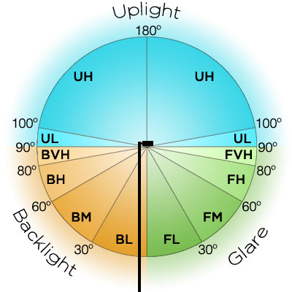
B.U.G. Ratings (Backlight, Uplight, and Glare)
Takethreelighting.com/bug-rating

Slide 2
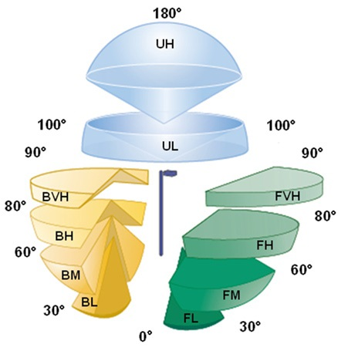
B.U.G. Ratings (Backlight, Uplight, and Glare)
Shop.innovativelight.com

Slide 3
Illuminating Engineering Society Cutoff Classifications
Full Cutoff: 0% light at 90* or above
Cutoff: Maximum of 2.5% at 90*
Semi-cutoff: Maximum of 5% at 90*
Non-cutoff: No limitation

Slide 4
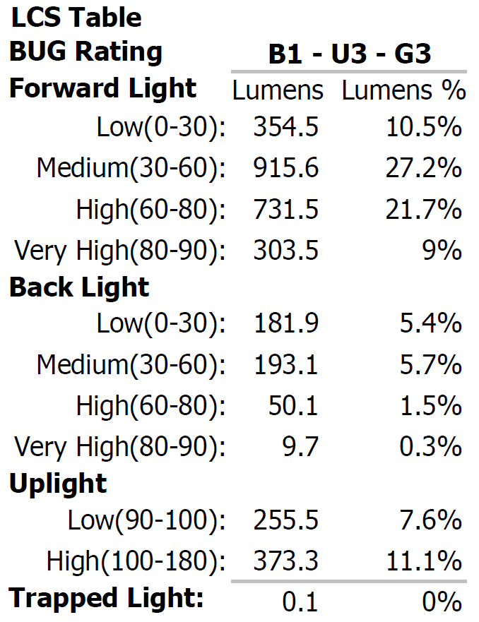
Proposed Lighting (details from Exhibit E)

Slide 5
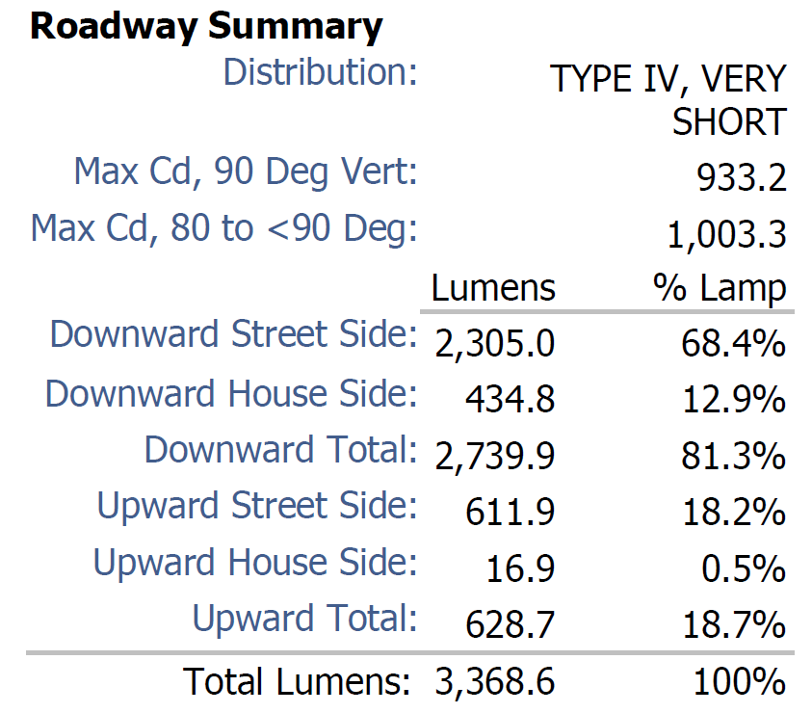
Proposed Lighting (details from Exhibit E)

Slide 6
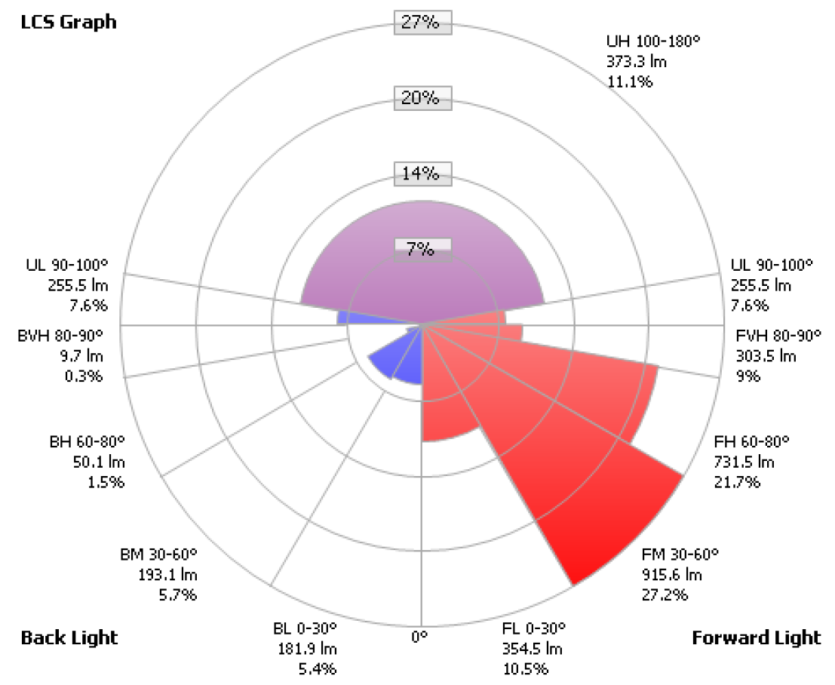
Proposed Lighting

Slide 7
Proposed Lighting

