Slide 1
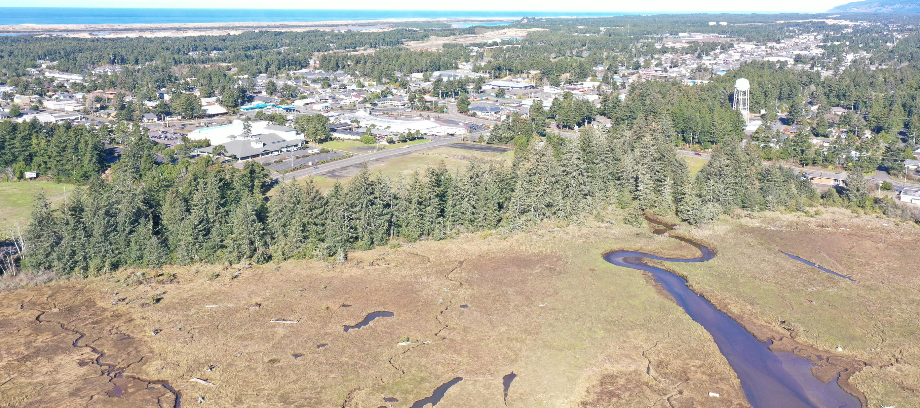
Siuslaw Estuary Trail Contract Award
MIKE MILLER, DIRECTOR PUBLIC WORKS

Slide 2
Bids
Laskey-Clifton Corp
$462,309.85
Ray Wells, Inc
$473,885.00
Morello Construction, Inc
$478,967.00
NW Construction General Contracting, Inc
$498,752.95
Cascade Civil
$514,513.00
Knife River
$523,862.25

Slide 3
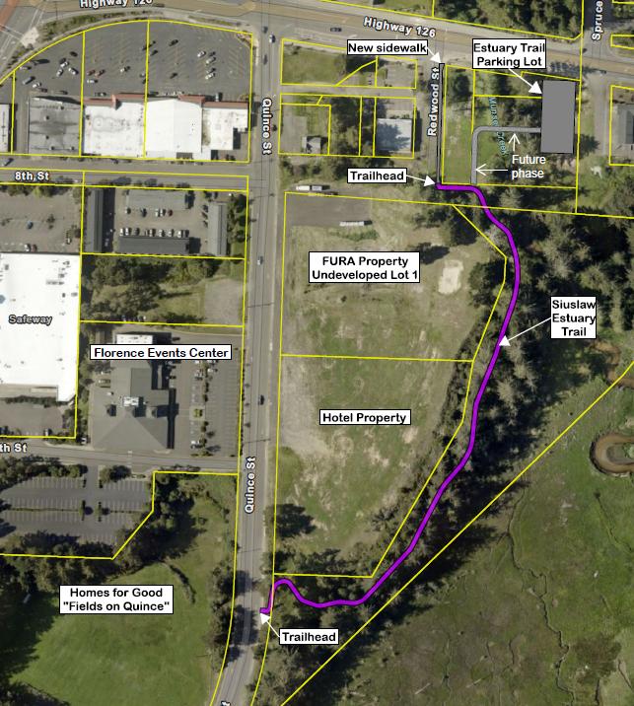
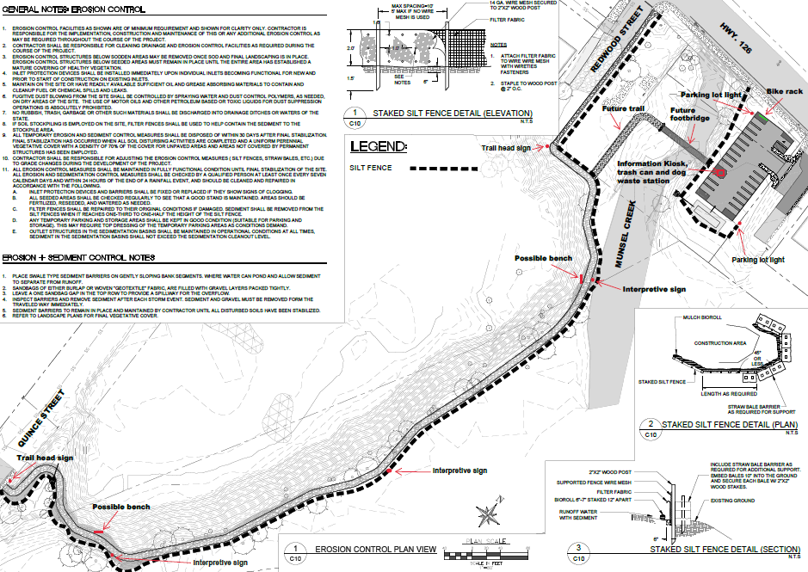

Slide 4
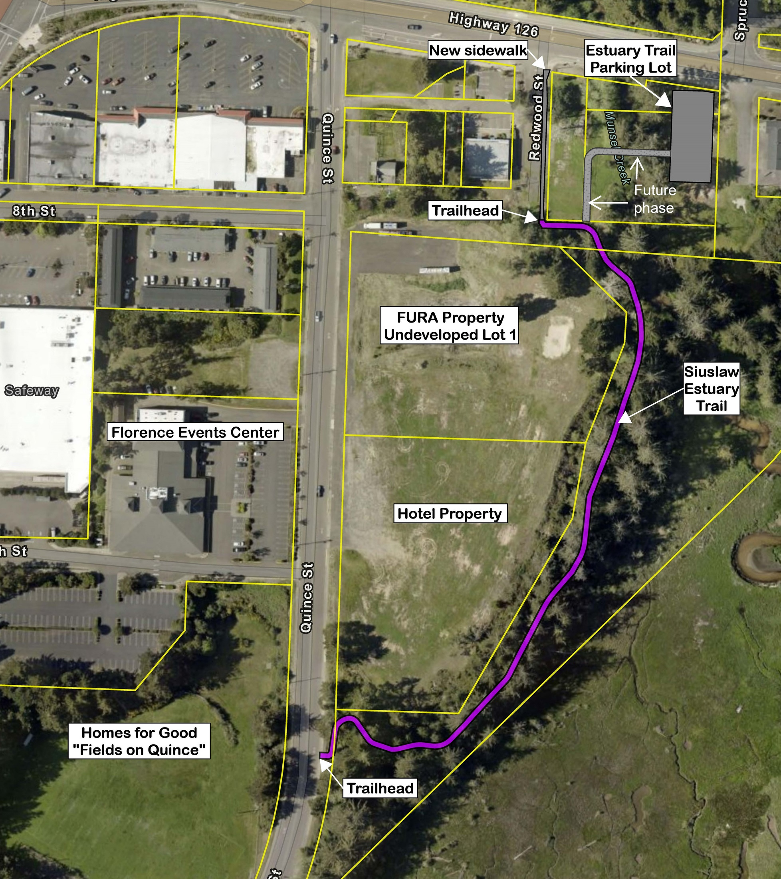
12,870 square feet of gravel pathway
50 cubic yards of foundation stabilization
229 lineal feet of curb/gutter
1,221 square feet of sidewalks
266 square feet of concrete driveway
316 square feet of valley gutter
516 lineal feet of standard vertical curb
440 cubic yards of aggregate base
310 tons of Level 3 Hot Mix Asphalt Cement (HMAC)
1,320 square yards of geotextile fabric
46 lineal feet of 12-inch stormwater line
50 lineal feet of 8-inch stormwater line
1 catch basin
Stormwater raingarden facility
20 cubic yards of 6-inch D50 Rip-rap
3 concrete bollards
18 tree removals
Painted striping and thermoplastic markings
Erosion and sediment control
Landscape restoration and cleanup

Slide 5
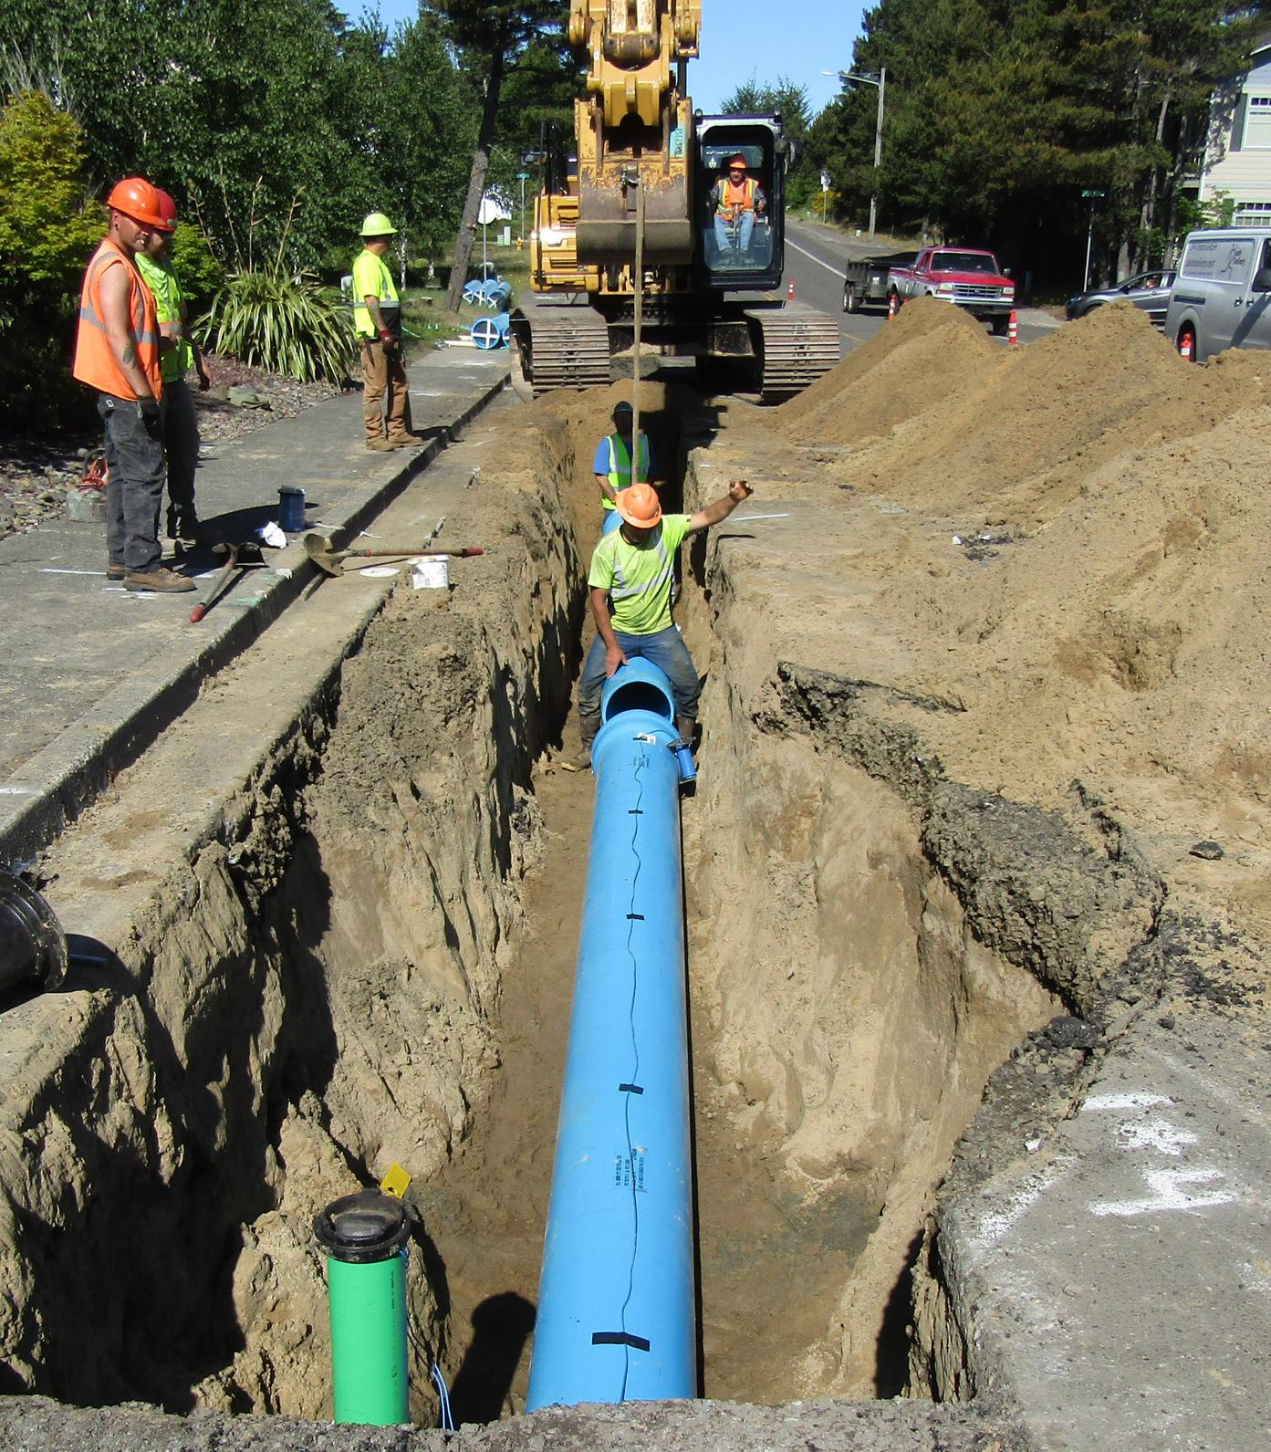
Projects Completed by Laskey-Clifton
project start - November 2023
Oregon State Parks
$4 million of water, sewer, electrical
and roadway replacement at the
Beverly Beach campground
2022
City of Reedsport
Sanitary Sewer Project
2022
City of Toledo
Waterline Project

Slide 6
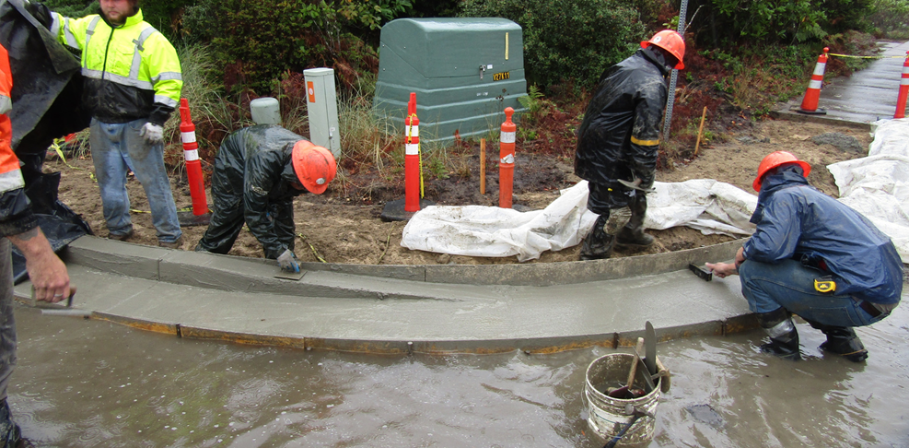
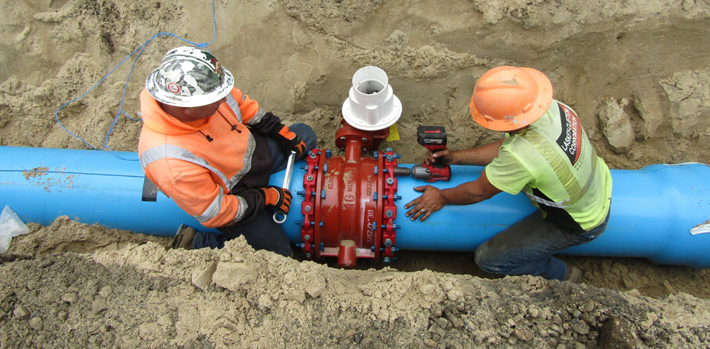
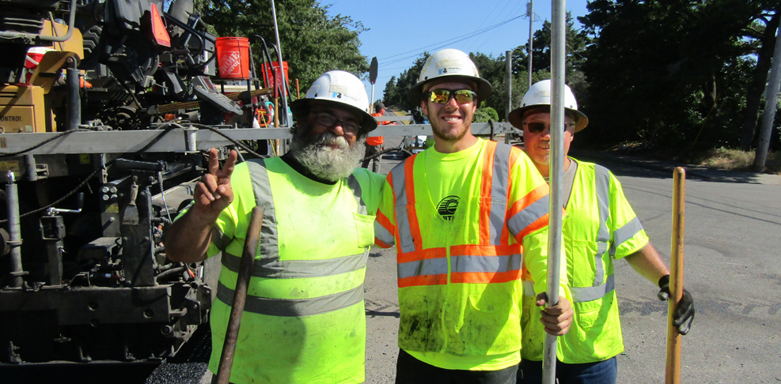

Slide 7
Fiscal Impact
Available Funding | Remaining Budget
Siuslaw Estuary Trail Project | $250,000
Quince Street Preliminary Engineering | $200,000
Capital Equipment Replacement – Dump truck purchase | $80,000
Total funds available for Siuslaw Estuary Trail Project | $530,000
Fund | Available Funds | Engineers Estimate (EE) | Bid | Bid Over/(Under) Funding | Bid Over/Under) EE
Street | $530,000 | $502,400 | $462,309.85 | ($67,690.15) | ($40,090.15)

Slide 8
The Siuslaw Estuary Trail Project is related to the City work plan objectives of:
Construction of the Siuslaw Estuary Trail -
Hwy 126 to Port of Siuslaw property
Relevance to Adopted City Work Plan:
City Service Delivery
Livability & Quality of Life
Economic Development
Communication & Trust
Financial & Organizational Sustainability

Slide 9
Alternatives
Recommendation
1. Award contract to Laskey-Clifton Corporation
2. Do not award proposal
3. Reject the proposals, re-scope the project and rebid
Staff recommends that the City Council accept the proposal from Laskey Clifton Corporation and authorize the City Manager or designee to proceed with a construction contract.

Slide 10
Questions
MIKE MILLER, DIRECTOR PUBLIC WORKS

